Slide 1
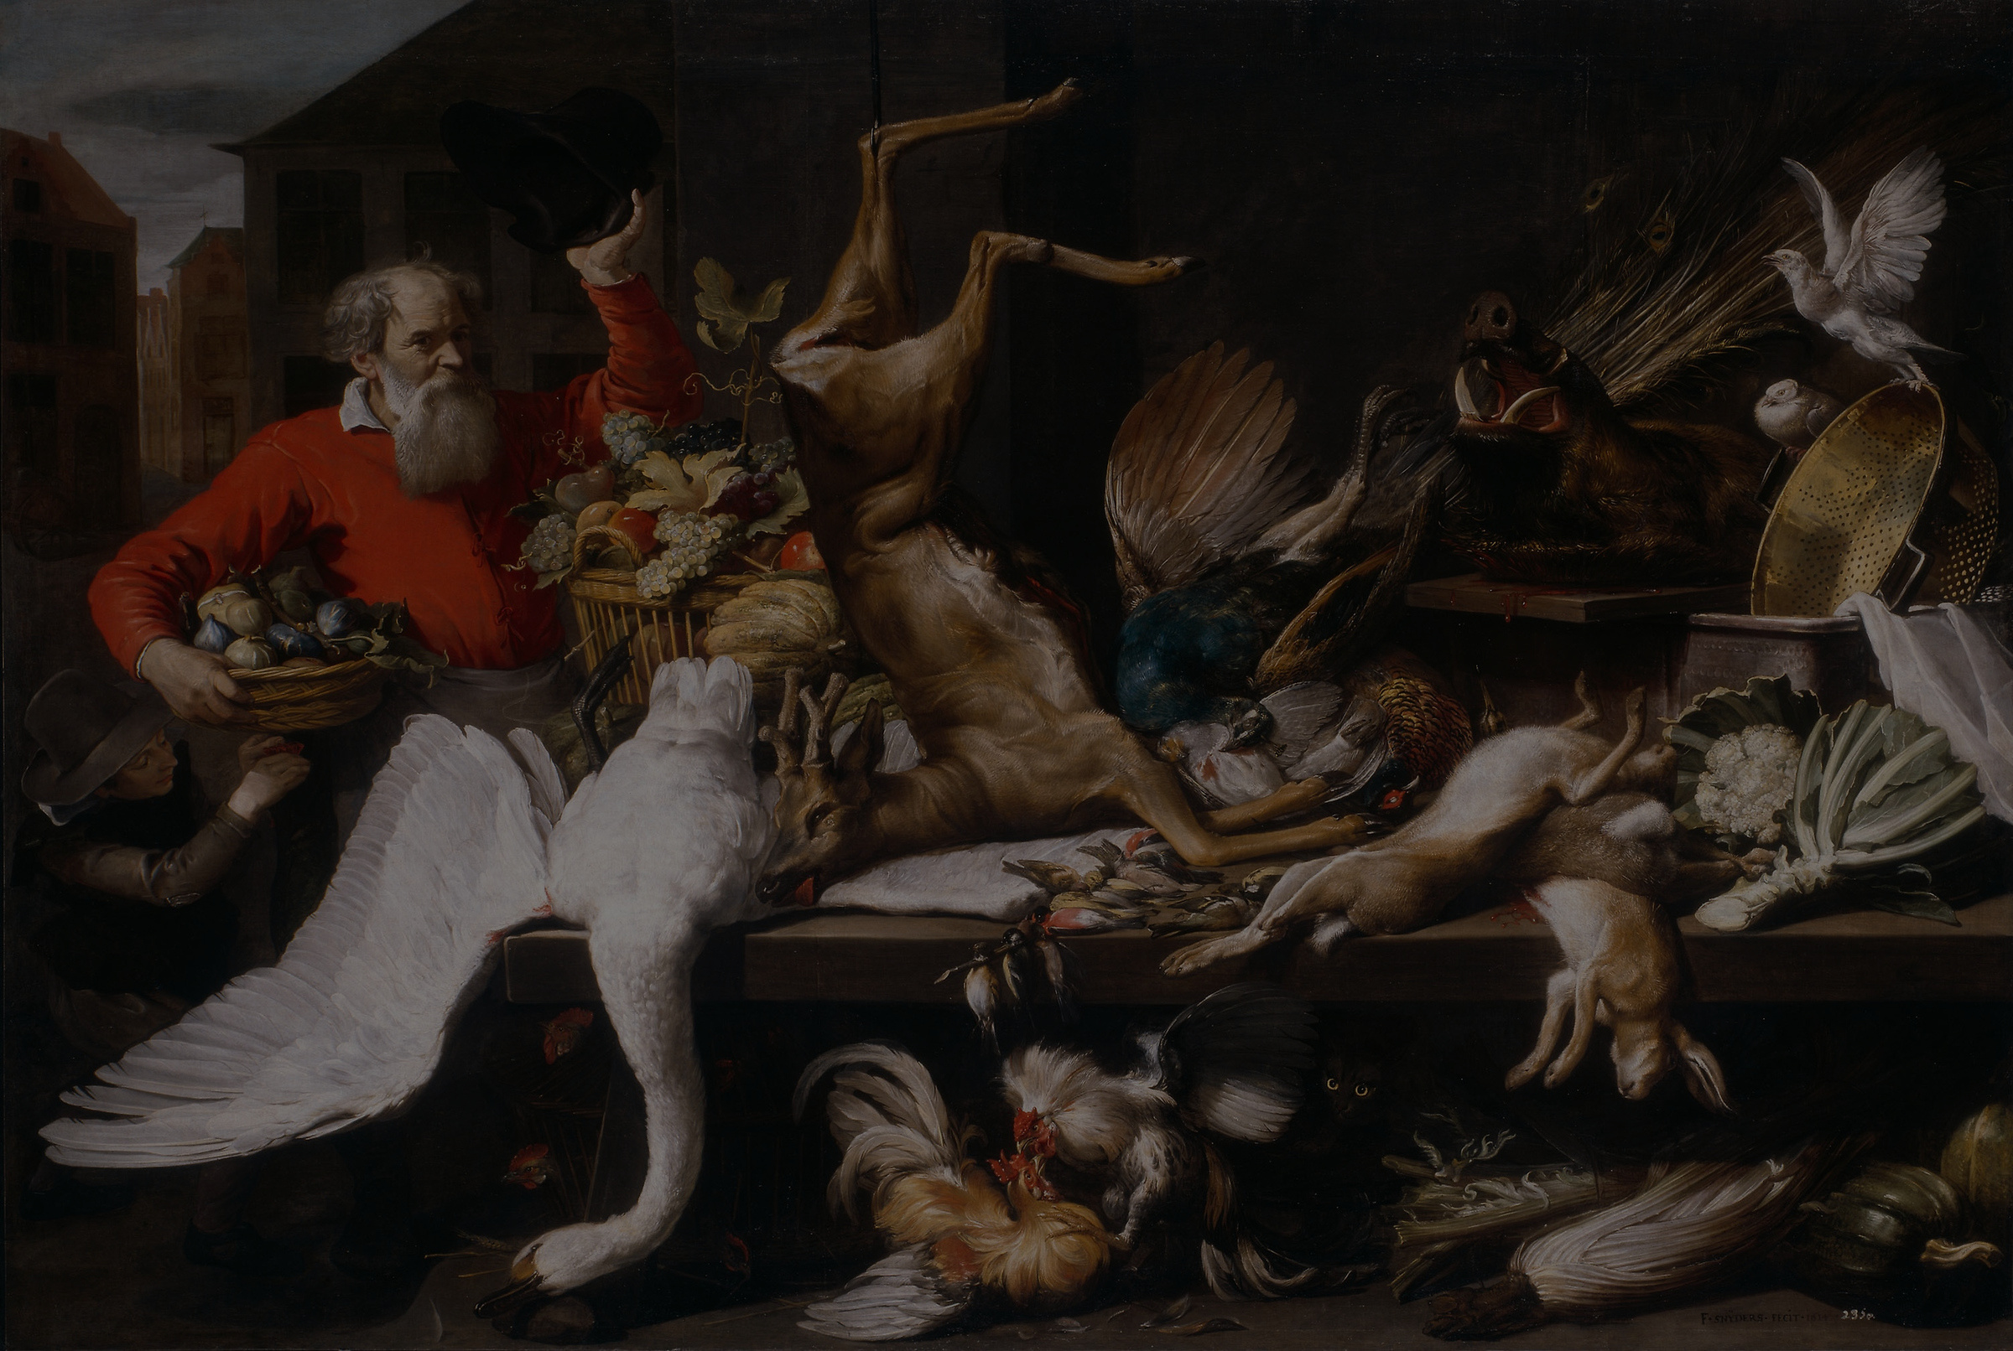


Presentation Template
history
art-
www.reallygreatsite.com

Slide 2
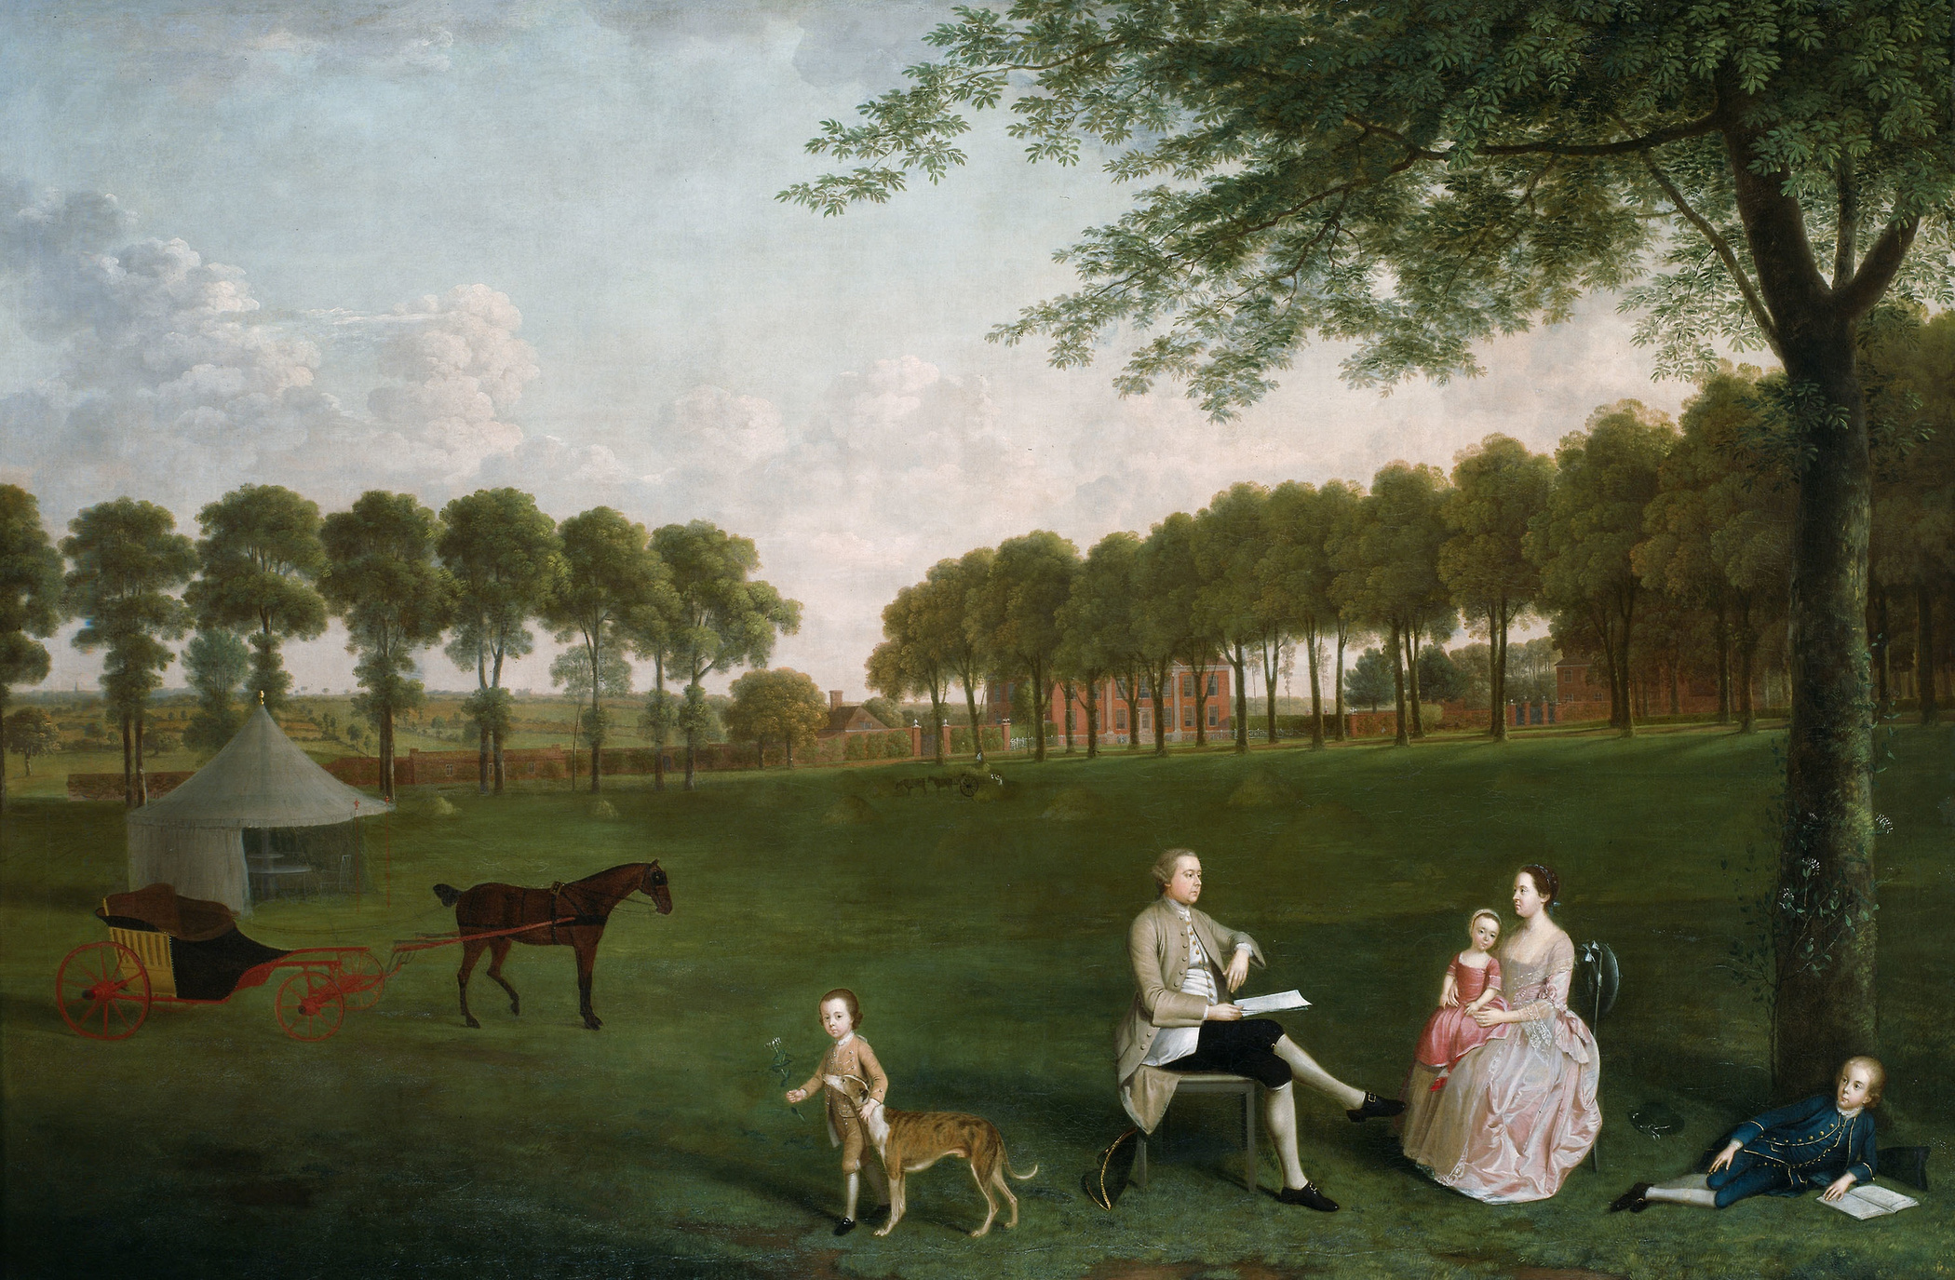
Ancient
Beginnings
Explore the origins of painting from prehistoric cave art to the monumental works of ancient civilizations like Egypt and Mesopotamia.
A presentation is a formal or informal communication method that involves conveying information, ideas, or a message to an audience. It often employs visual aids such as slides, charts, graphs, or multimedia elements to support and enhance the spoken content.

Slide 3
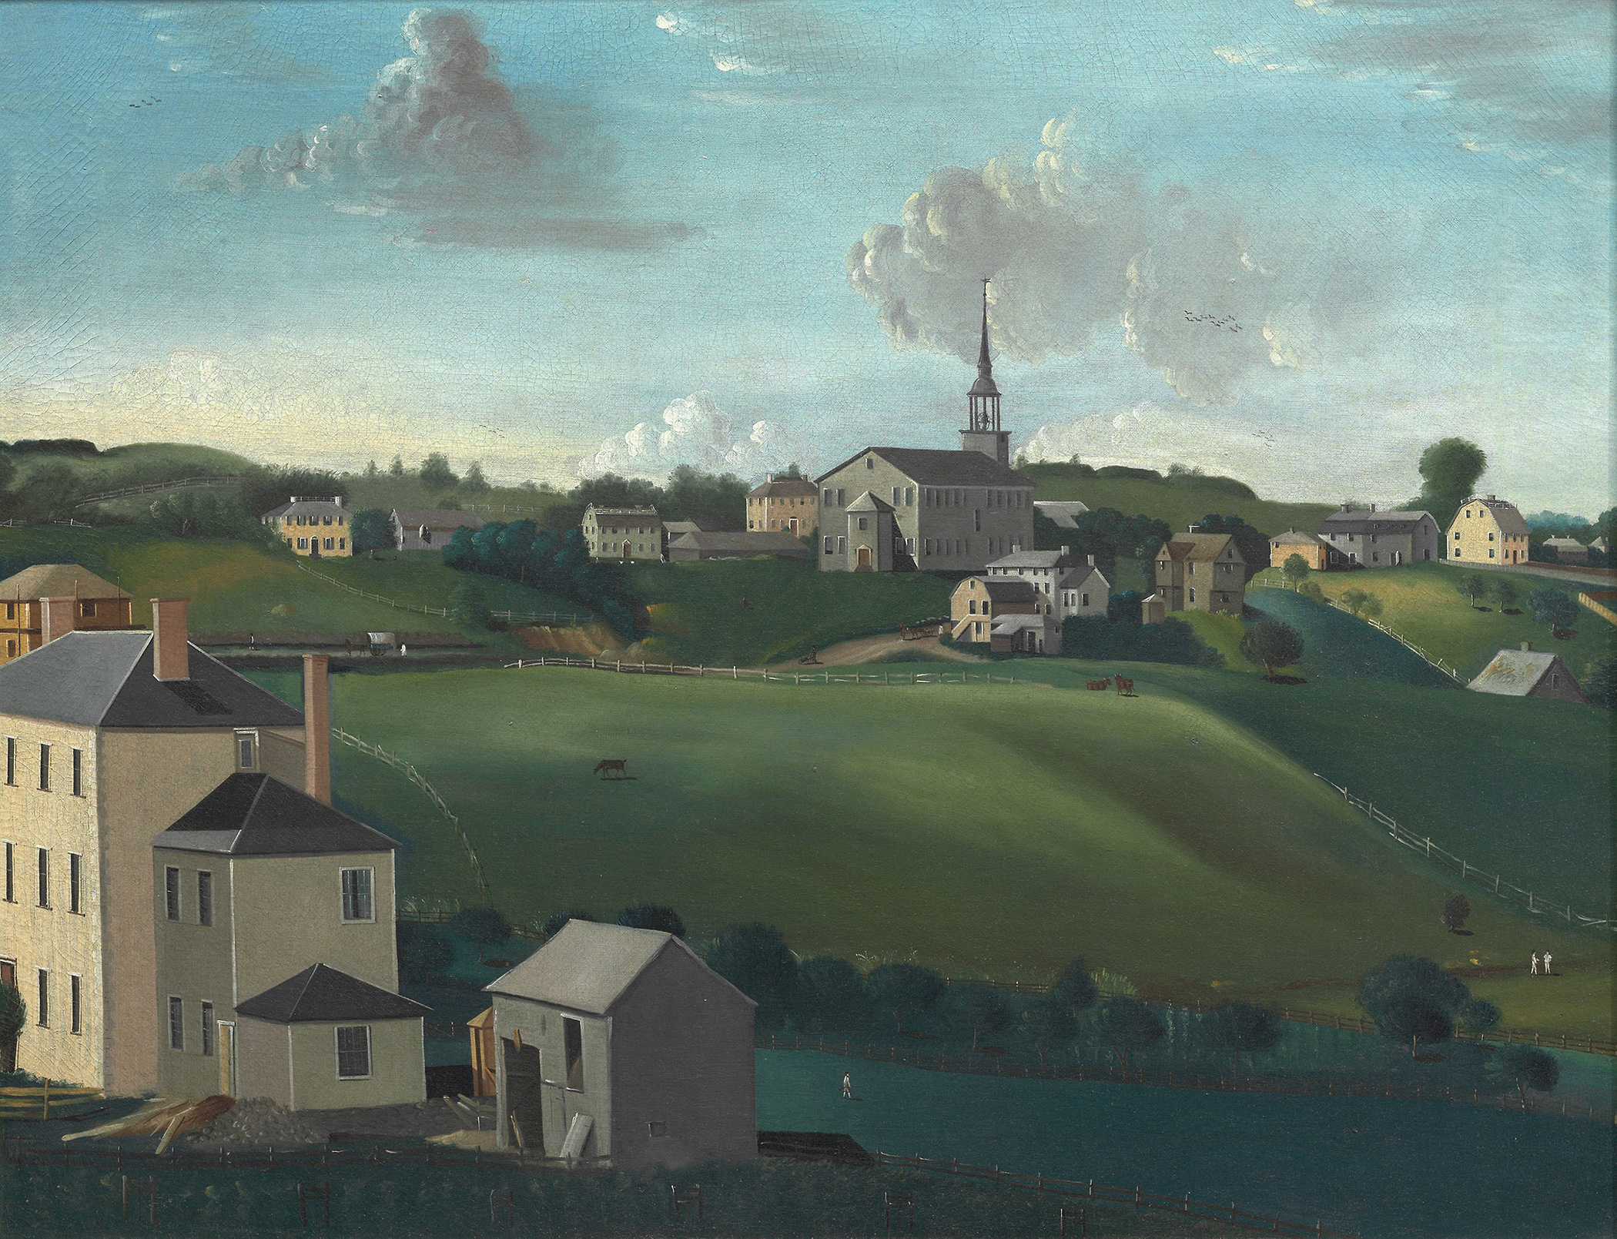
Delve into the painting and frescoes of Ancient Greece and Rome, highlighting the focus on realism, proportion, and mythological themes.
Classical
A presentation is a formal or informal communication method that involves conveying information, ideas, or a message to an audience. It often employs visual aids such as slides, charts, graphs, or multimedia elements to support and enhance the spoken content.
Antiquity

Slide 4
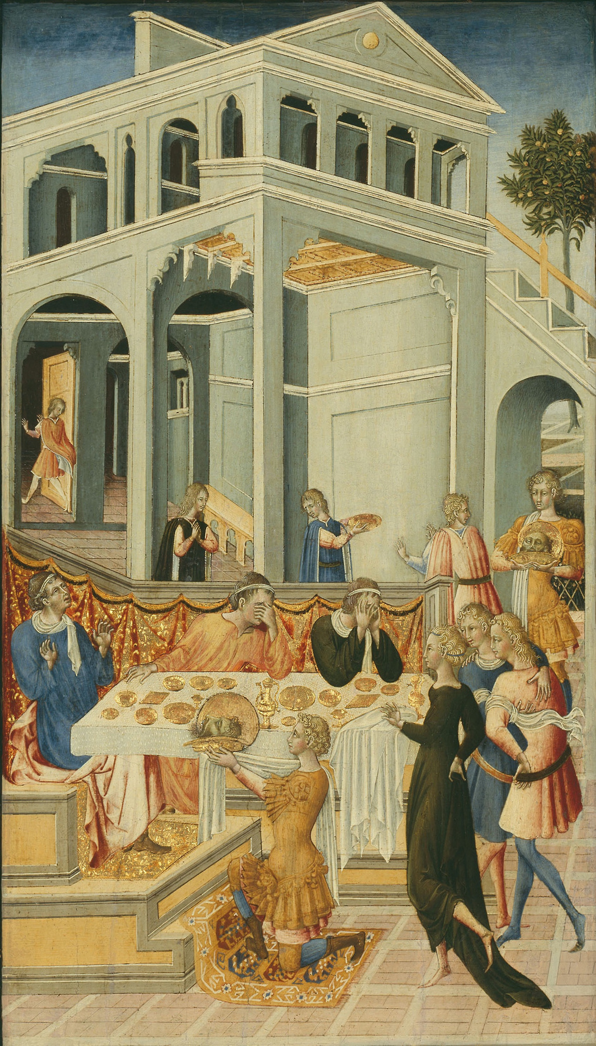
Discover the religious and symbolic paintings of the Middle Ages, including Byzantine icons and illuminated manuscripts.
A presentation is a formal or informal communication method that involves conveying information, ideas, or a message to an audience. It often employs visual aids such as slides, charts, graphs, or multimedia elements to support and enhance the spoken content.
Medieval
Art

Slide 5
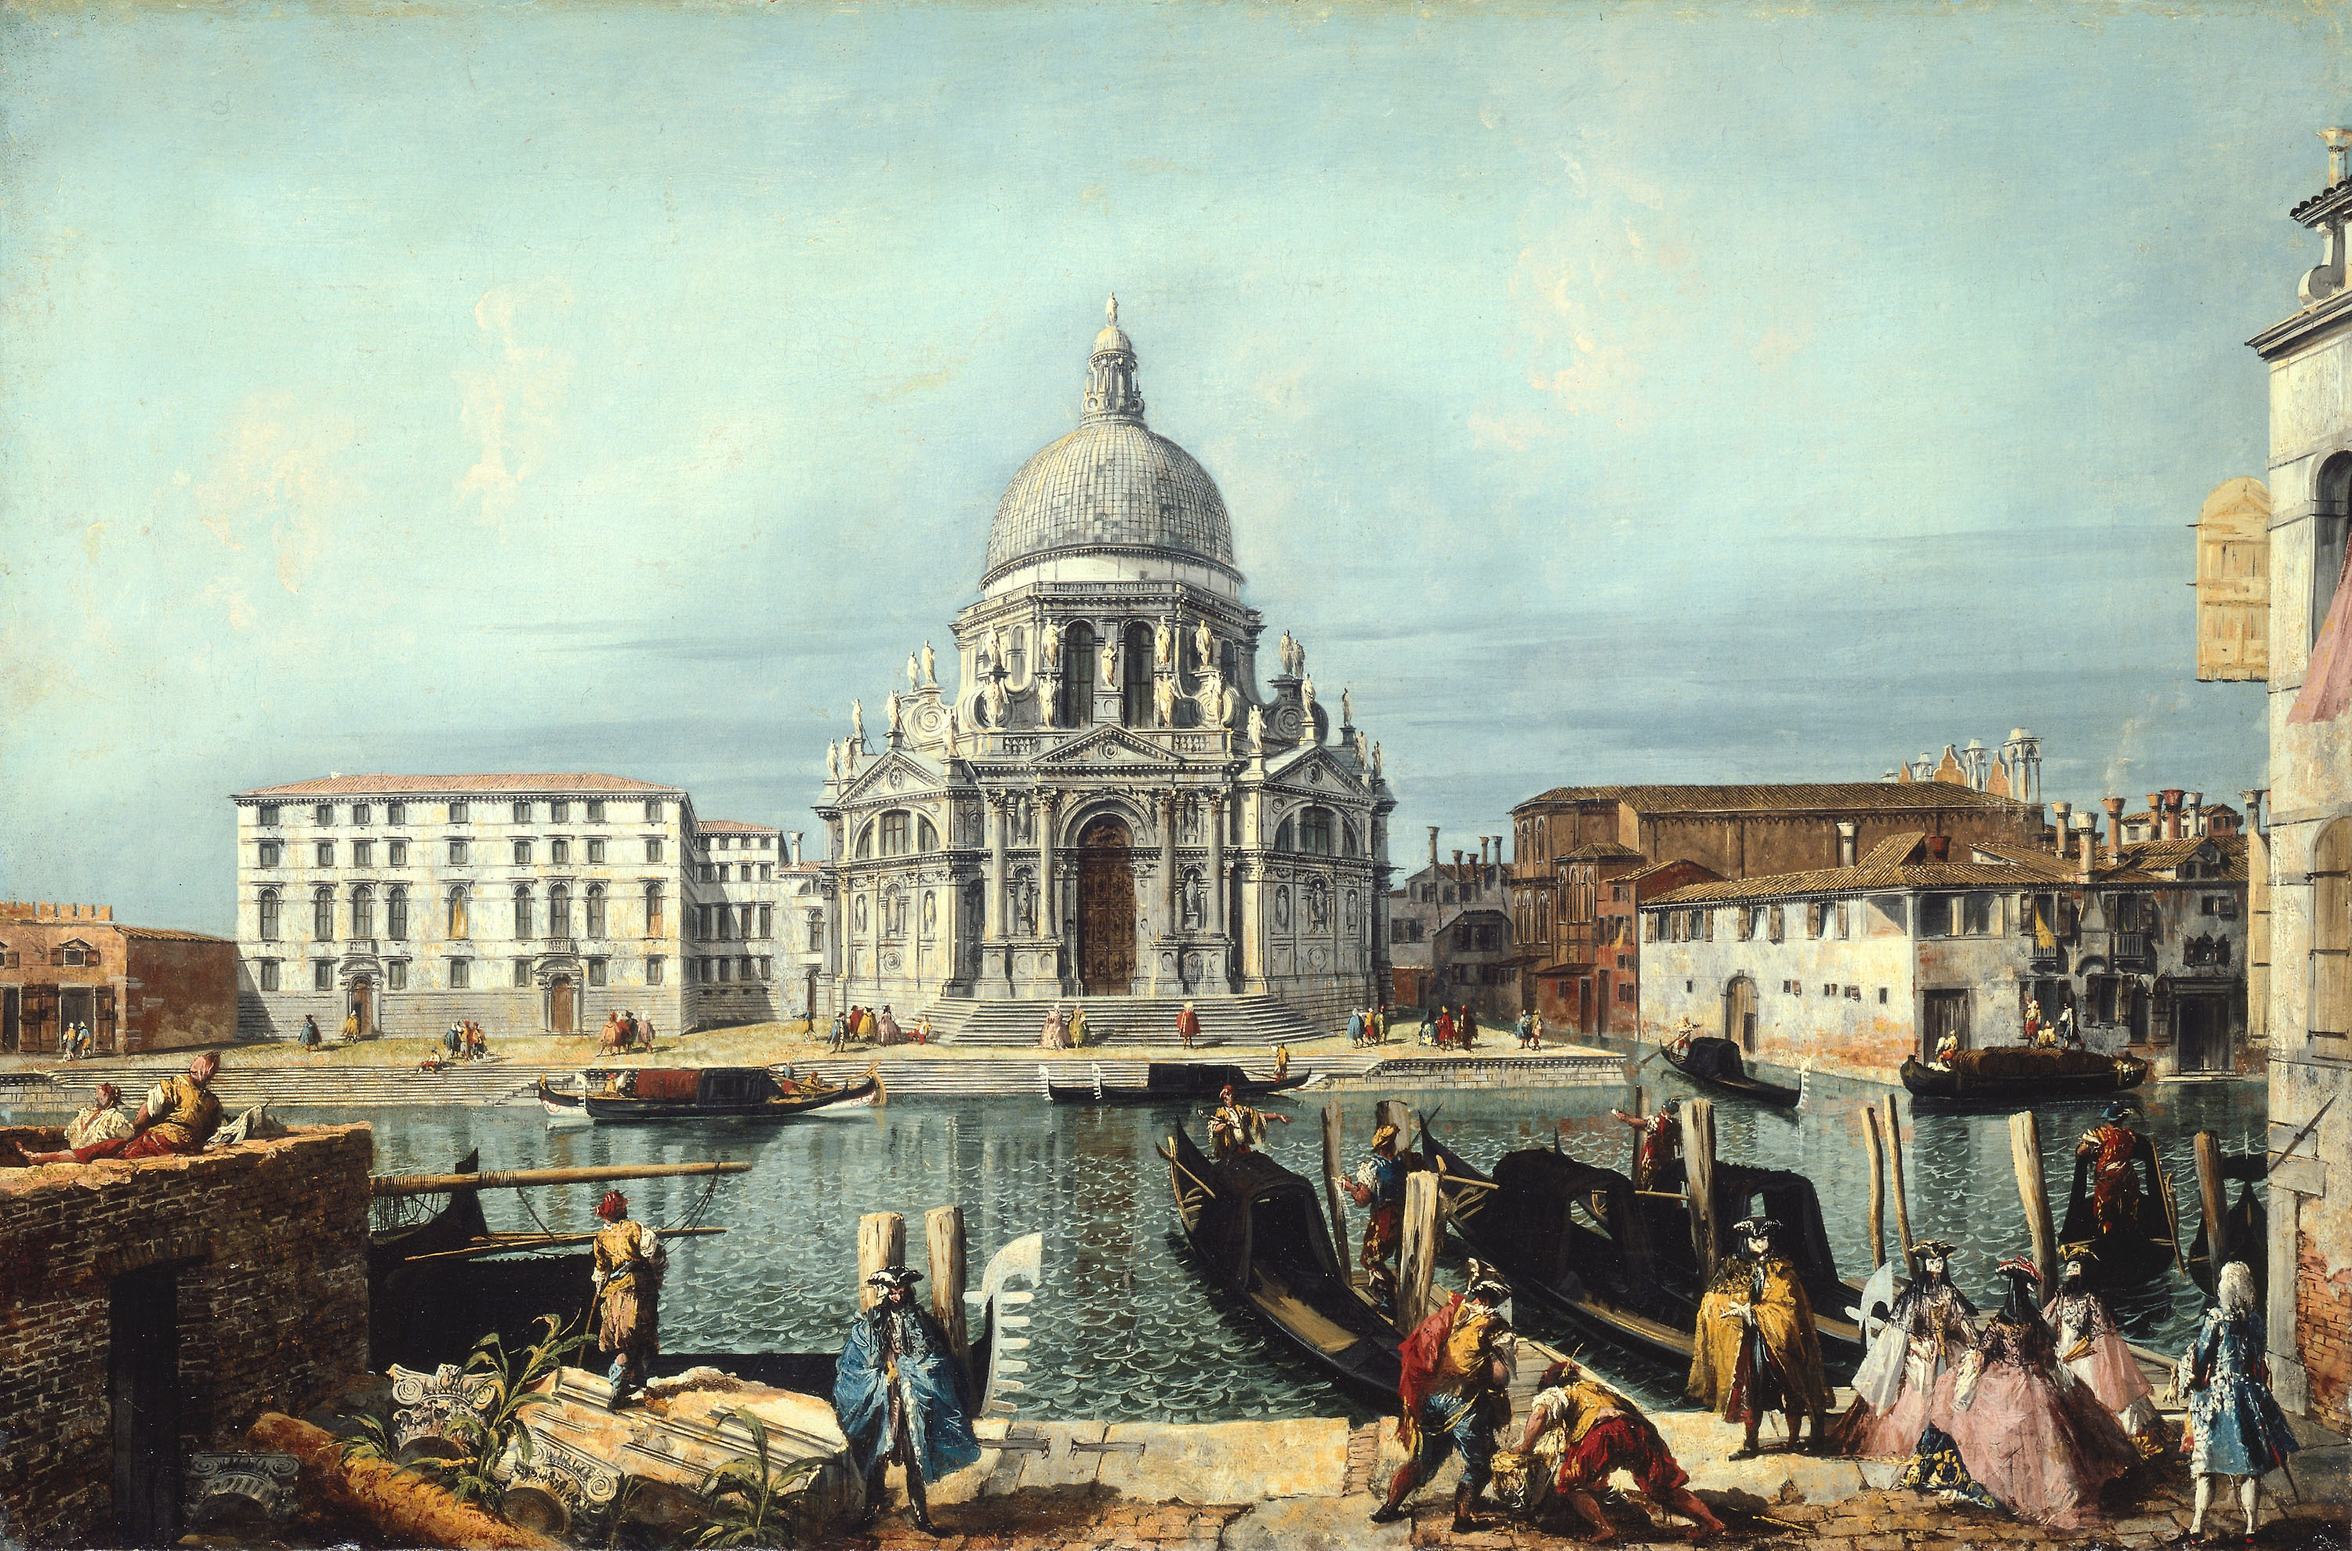
Investigate the rebirth of classical painting ideals during the Renaissance, featuring masters like Leonardo da Vinci, Michelangelo, and Raphael.
Renaissance
A presentation is a formal or informal communication method that involves conveying information, ideas, or a message to an audience. It often employs visual aids such as slides, charts, graphs, or multimedia elements to support and enhance the spoken content.
Revival

Slide 6
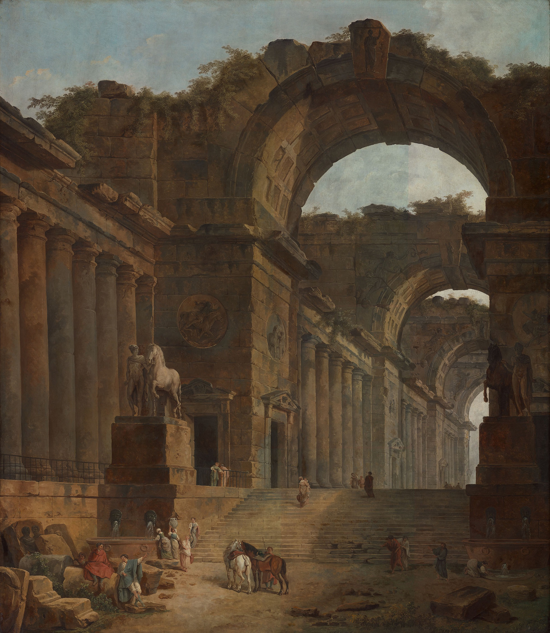
nvestigate the rebirth of classical painting ideals during the Renaissance, featuring masters like Leonardo da Vinci, Michelangelo, and Raphael.
Baroque
and
A presentation is a formal or informal communication method that involves conveying information, ideas, or a message to an audience. It often employs visual aids such as slides, charts, graphs, or multimedia elements to support and enhance the spoken content.
Rococo

Slide 7
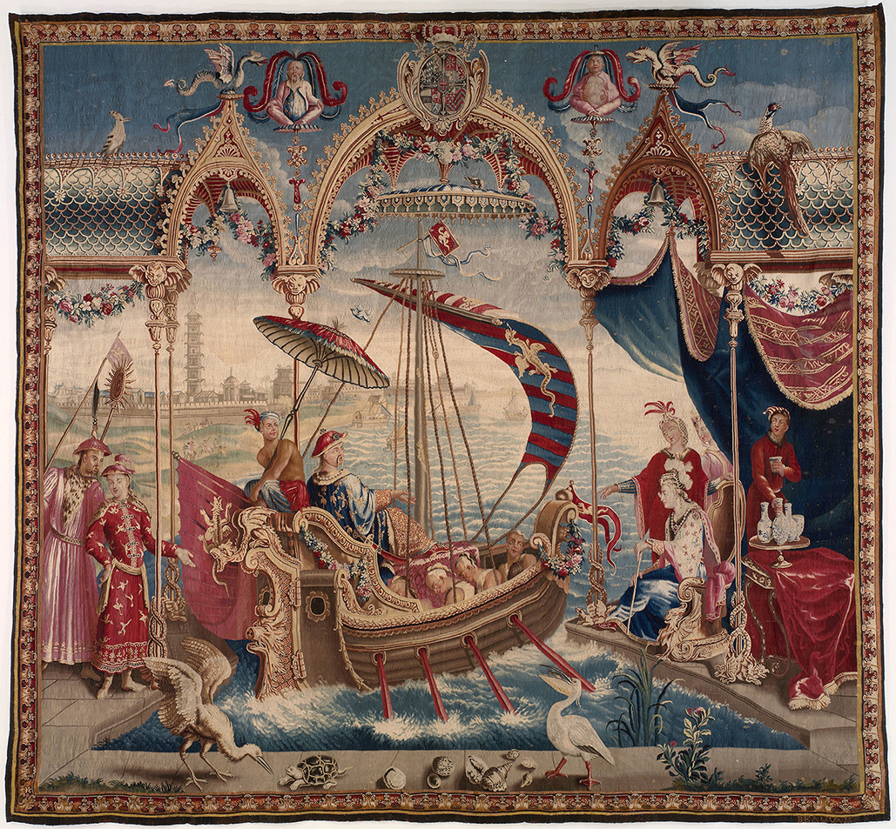
The Age
of Enlightenment
Examine the Enlightenment's focus on reason and science in painting, particularly in Neoclassicism and artists like Jacques-Louis David.
A presentation is a formal or informal communication method that involves conveying information, ideas, or a message to an audience. It often employs visual aids such as slides, charts, graphs, or multimedia elements to support and enhance the spoken content.

Slide 8
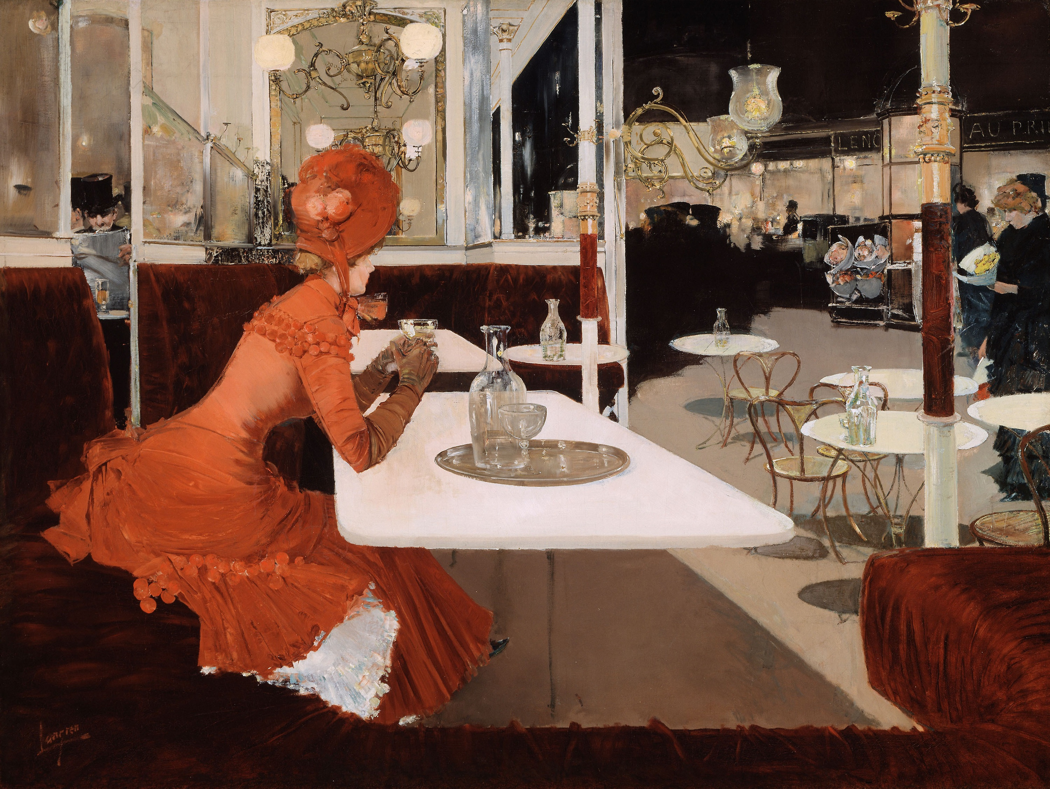
Analyze the break from traditional painting in the 19th and 20th centuries, with movements such as Impressionism, Cubism, and Surrealism, led by artists like Monet, Picasso, and Dalí.
Modern
Movements
A presentation is a formal or informal communication method that involves conveying information, ideas, or a message to an audience. It often employs visual aids such as slides, charts, graphs, or multimedia elements to support and enhance the spoken content.

Slide 9
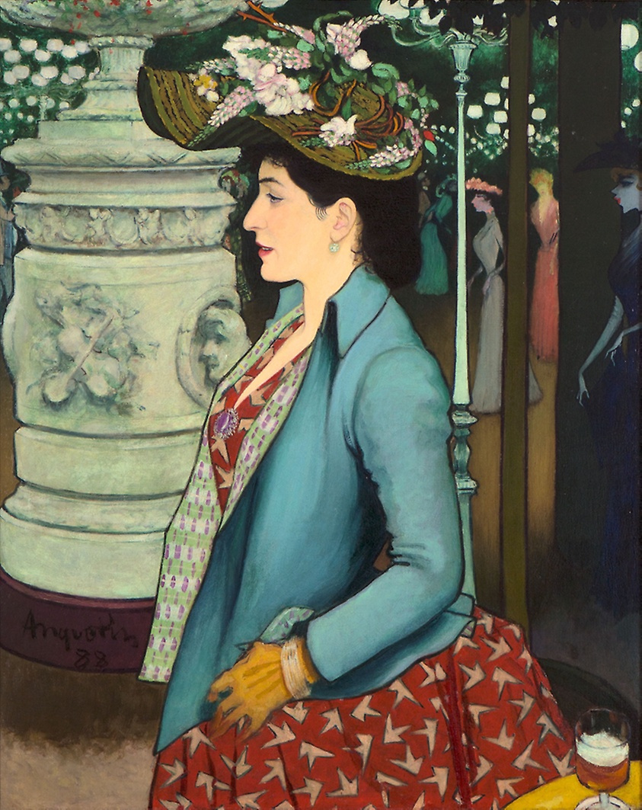
Reflect on the diverse and global nature of contemporary painting, encompassing new media, installations, and performance art.
A presentation is a formal or informal communication method that involves conveying information, ideas, or a message to an audience. It often employs visual aids such as slides, charts, graphs, or multimedia elements to support and enhance the spoken content.
Contemporary
Expression

Slide 10
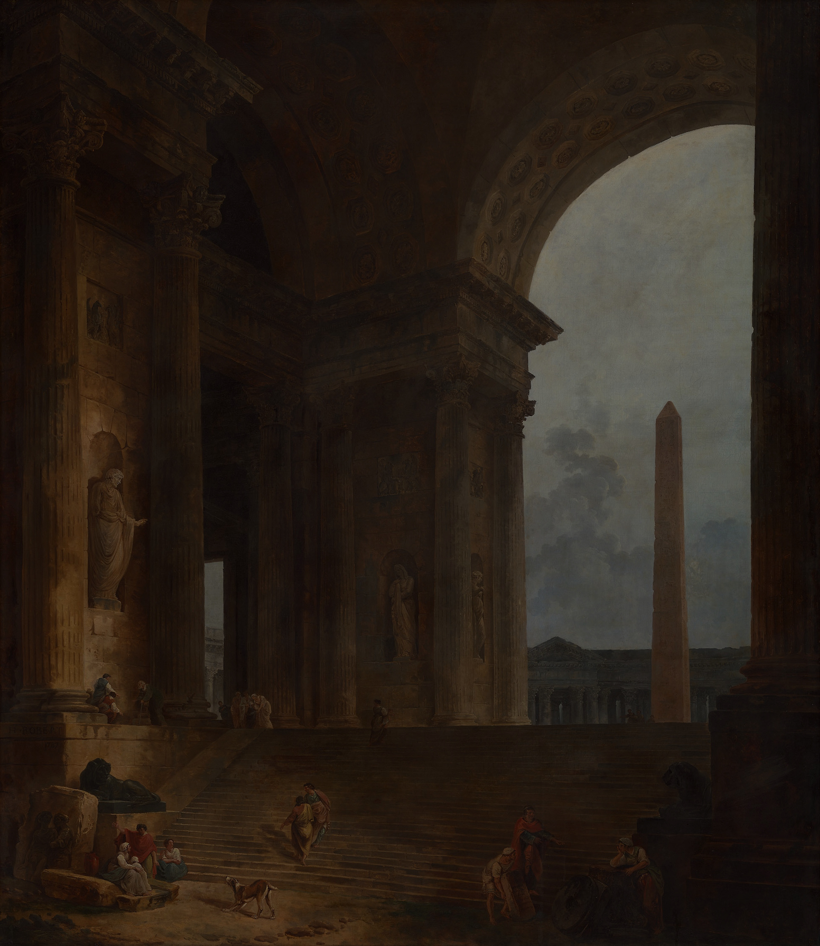
Thank you
for your attention

